Slide 1
INVEST Program Materials
Thank you for your interest in the INVEST program. Development of INVEST program materials was supported by a cooperative agreement (U01IP001095) between Duke University and the Centers for Disease Control and Prevention. Study team members from Duke University and the University of South Carolina worked collaboratively to develop these materials.
Please customize the INVEST materials for your school (district). Yellow/Grey highlighted sections are editable and need information from your school. Please download the font Quicksand SemiBold to match the font used in most materials.
This package includes the following materials:
Orientation letter (slide #2)
Sample Vaccination resource list (slide #3)
Follow-up vaccination infographic (slides #4-5)
Newsletter 1 (slides #6-7)
Newsletter 2 (slides #8-9)
Newsletter 3 (slides #10-11)
Newsletter 4 (slides #12-13)
Newsletter 5 (slides #14-15)
Newsletter 6 (slides #16-17)
For more information on rural-urban disparities in HPV vaccination coverage, please refer to the following INVEST program publications:
Vasudevan, L., Ostermann, J., Wang, Y., Harrison, S. E., Yelverton, V., McDonald, J. A., ... & Walter, E. B. (2021). Predictors of HPV vaccination in the southern US: A survey of caregivers from 13 states. Vaccine, 39(51), 7485-7493. https://doi.org/10.1016/j.vaccine.2021.10.036
Harrison, S. E., Yelverton, V., Wang, Y., Ostermann, J., Fish, L. J., Williams, C. L., ... & Walter, E. B. (2021). Examining Associations between Knowledge and Vaccine Uptake Using the Human Papillomavirus Knowledge Questionnaire (HPV-KQ). American journal of health behavior, 45(5), 810-827. https://doi.org/10.5993/AJHB.45.5.2
Fish, L. J., Harrison, S. E., McDonald, J. A., Yelverton, V., Williams, C., Walter, E. B., & Vasudevan, L. (2022). Key stakeholder perspectives on challenges and opportunities for rural HPV vaccination in North and South Carolina. Human Vaccines & Immunotherapeutics, 1-8. https://doi.org/10.1080/21645515.2022.2058264
Vasudevan, L., Ostermann, J., Wang, Y., Harrison, S. E., Yelverton, V., Fish, L. J., ... & Walter, E. B. (2022). Association of caregiver attitudes with adolescent HPV vaccination in 13 southern US states. Vaccine: X, 11, 100181. https://doi.org/10.1016/j.jvacx.2022.100181
THANK YOU,
Your INVEST study team!

Slide 2
Add: School name .
Add:
School nurse’s name
Contact info
Slogan or quote
Add: Picture of school nurse here
Add: QR code here
Add: Survey link here
Add: School (district) logo here

Slide 3
Vaccination Resource List
Please see below a list of providers in your area who vaccinate middle schoolers. Vaccines for Children is a program designed to provide vaccines to children who qualify at no charge. The information listed below is subject to change, so please call the provider’s office if you have questions.
PEDIATRICIAN AND FAMILY MEDICINE PARCTICES
Practice and providers | Address | Phone and website | Accepting new patients* | Member of Vaccines for Children | Accepted insurances
[Add: Contact information of local vaccination providers including pediatricians, family medicine and immediate care offices]
* Information collected as of MONTH YEAR. Please check with your doctor’s office as it may change over time
COUNTY PUBLIC HEALTH DEPARTMENT
Address | Phone and website | Member of Vaccines for Children | Appointment required
[Add: Contact information county health department]

Slide 4
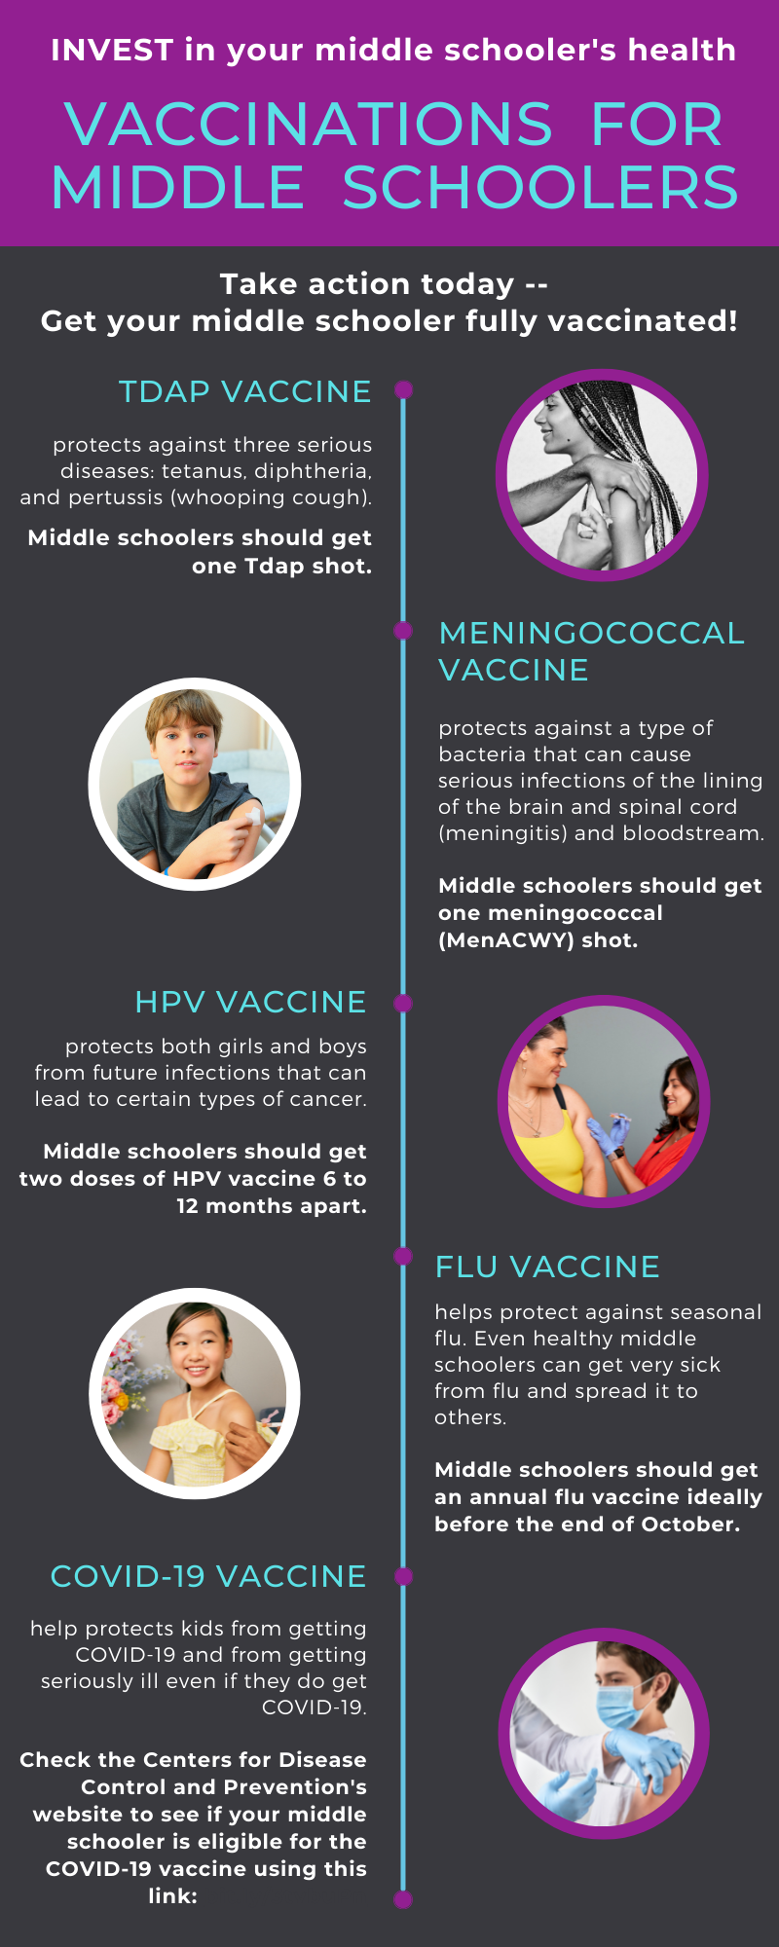
bit.ly/3tvbuPn

Slide 5
Add: NAME OF SCHOOL NURSE
Add: Picture of school nurse here
[Add: school nurse’s phone number, e-mail address
Quote/slogan] .
[Add: Contact information of local vaccination providers including pediatricians, family medicine and immediate care offices, and the county health department] .
Add: School (district) logo here

Slide 6
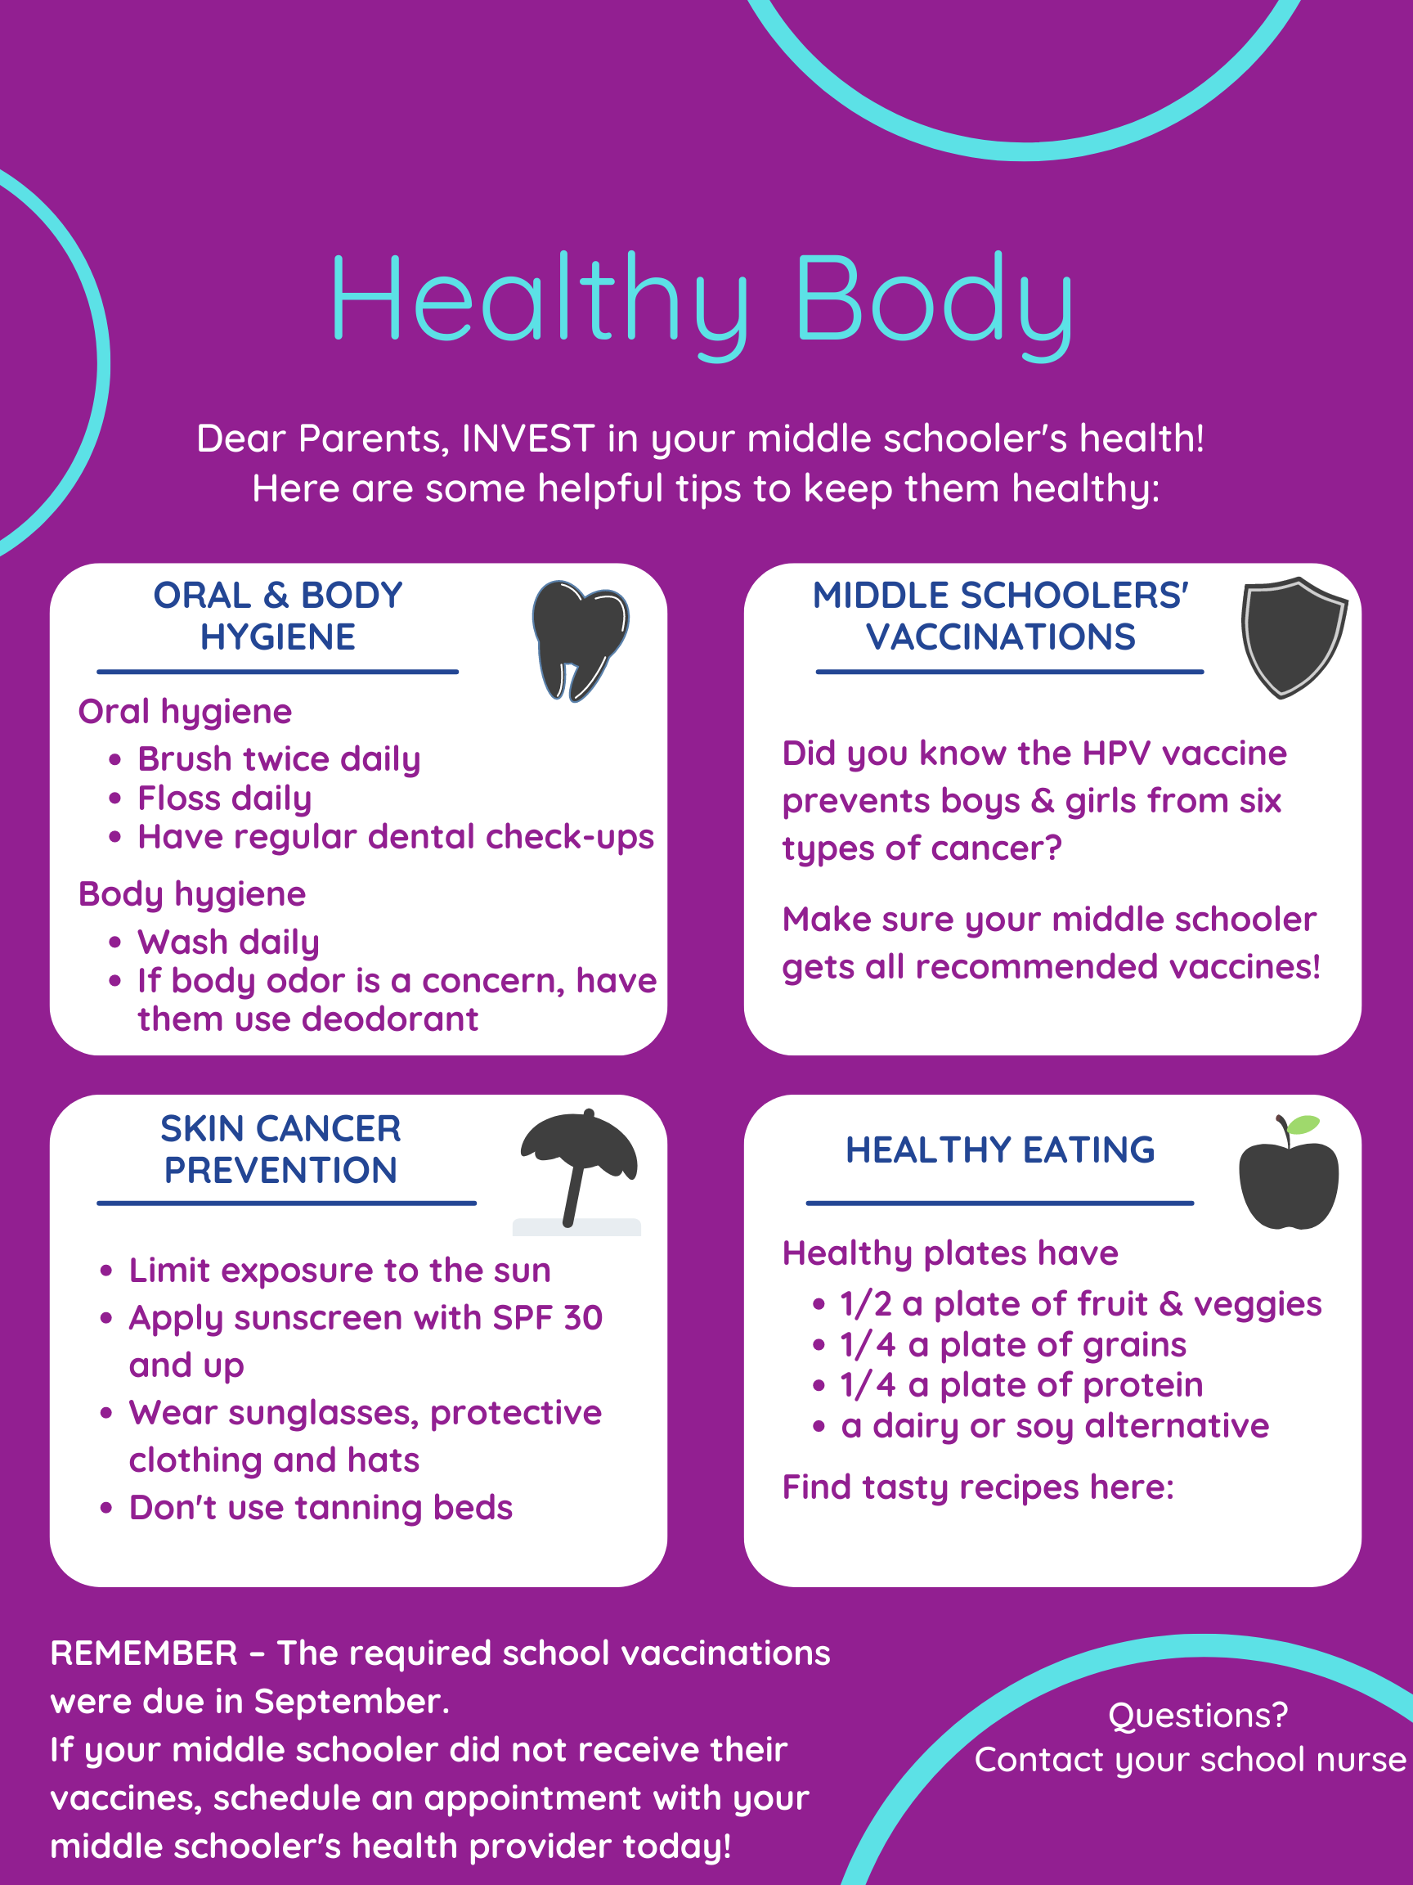
Add: School (district) logo here
www.myplate.gov
Add: School nurse’s name
Contact info .

Slide 7
Add: School (district) logo here
bit.ly/36FZgsH
bit.ly/3z4y5DT
bit.ly/3ilfUmD
bit.ly/2UW5xxW
[Add: Contact information of local vaccination providers including pediatricians, family medicine and immediate care offices, and the county health department]

Slide 8
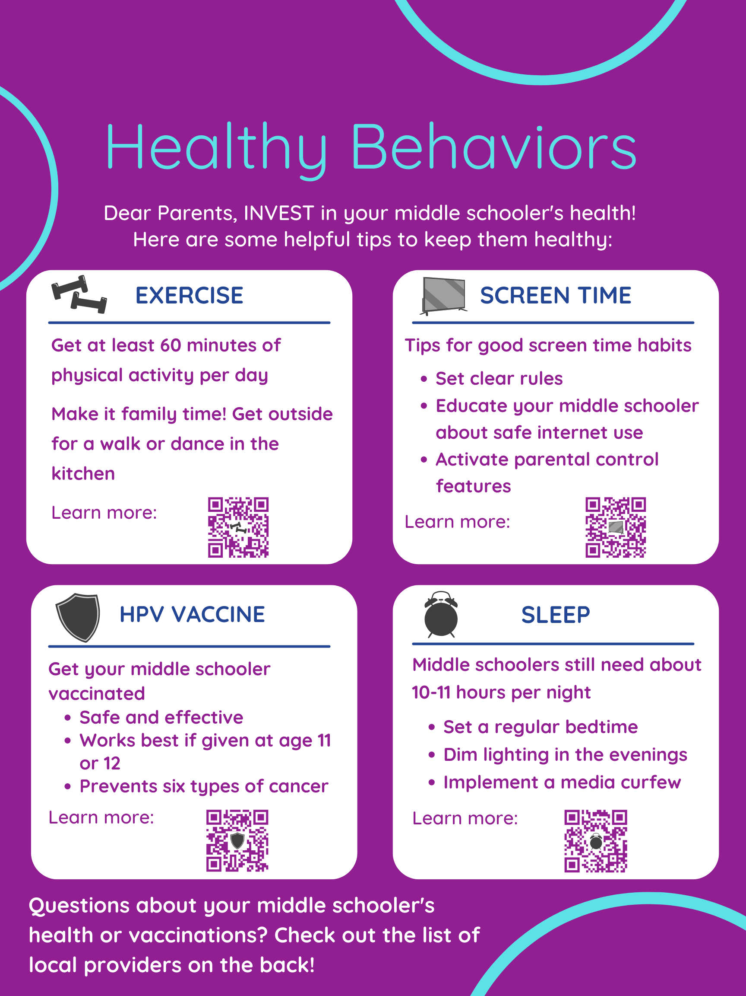
Add: School (district) logo here
bit.ly/3iLqP9A
bit.ly/3eZcMMm
bit.ly/3BLxdpW
bit.ly/3ydEz3C

Slide 9
Add: School (district) logo here
Add:
SCHOOL NURSE’S NAME
Contact info
Slogan or quote
Add: Picture of school nurse here
[Add: Contact information of local vaccination providers including pediatricians, family medicine and immediate care offices, and the county health department]

Slide 10
Add: School (district) logo here
bit.ly/3i5T8R5
bit.ly/3x6xXCD
bit.ly/3eXqtvo
bit.ly/3nZNGTe

Slide 11
Add: School (district) logo here
Add:
SCHOOL NURSE’S NAME
Contact info
Slogan or quote
Add: Picture of school nurse here
[Add: Contact information of local vaccination providers including pediatricians, family medicine and immediate care offices, and the county health department]

Slide 12
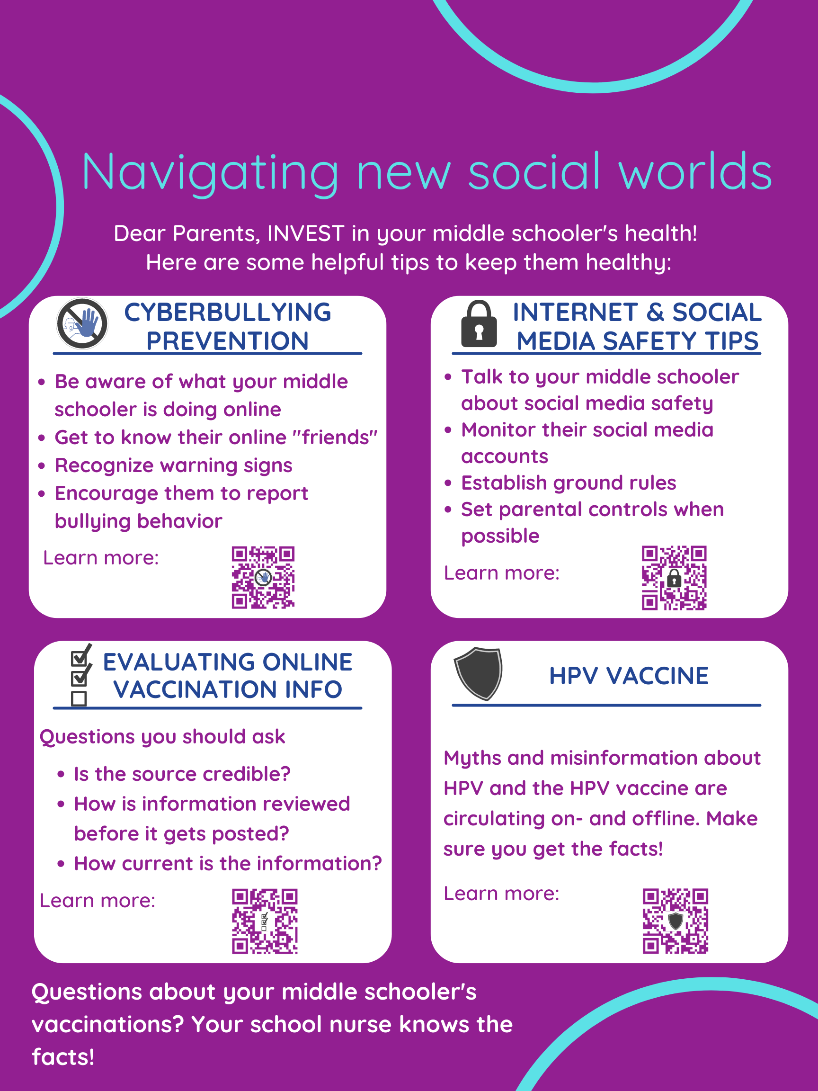
Add: School (district) logo here
bit.ly/31gX0IZ
bit.ly/3GCv4zl
bit.ly/3EwH7ws
bit.ly/3vZH1dy

Slide 13
Add: School (district) logo here
Add:
SCHOOL NURSE’S NAME
Contact info
Slogan or quote
Add: Picture of school nurse here
[Add: Contact information of local vaccination providers including pediatricians, family medicine and immediate care offices, and the county health department]

Slide 14
Add: School (district) logo here
bit.ly/2ZvWo1b
bit.ly/3GBMex5
bit.ly/3msdHJs
bit.ly/3nMonC2
bit.ly/2ZNwoid

Slide 15
Add: School (district) logo here
Add:
SCHOOL NURSE’S NAME
Contact info
Slogan or quote
Add: Picture of school nurse here
[Add: Contact information of local vaccination providers including pediatricians, family medicine and immediate care offices, and the county health department]

Slide 16
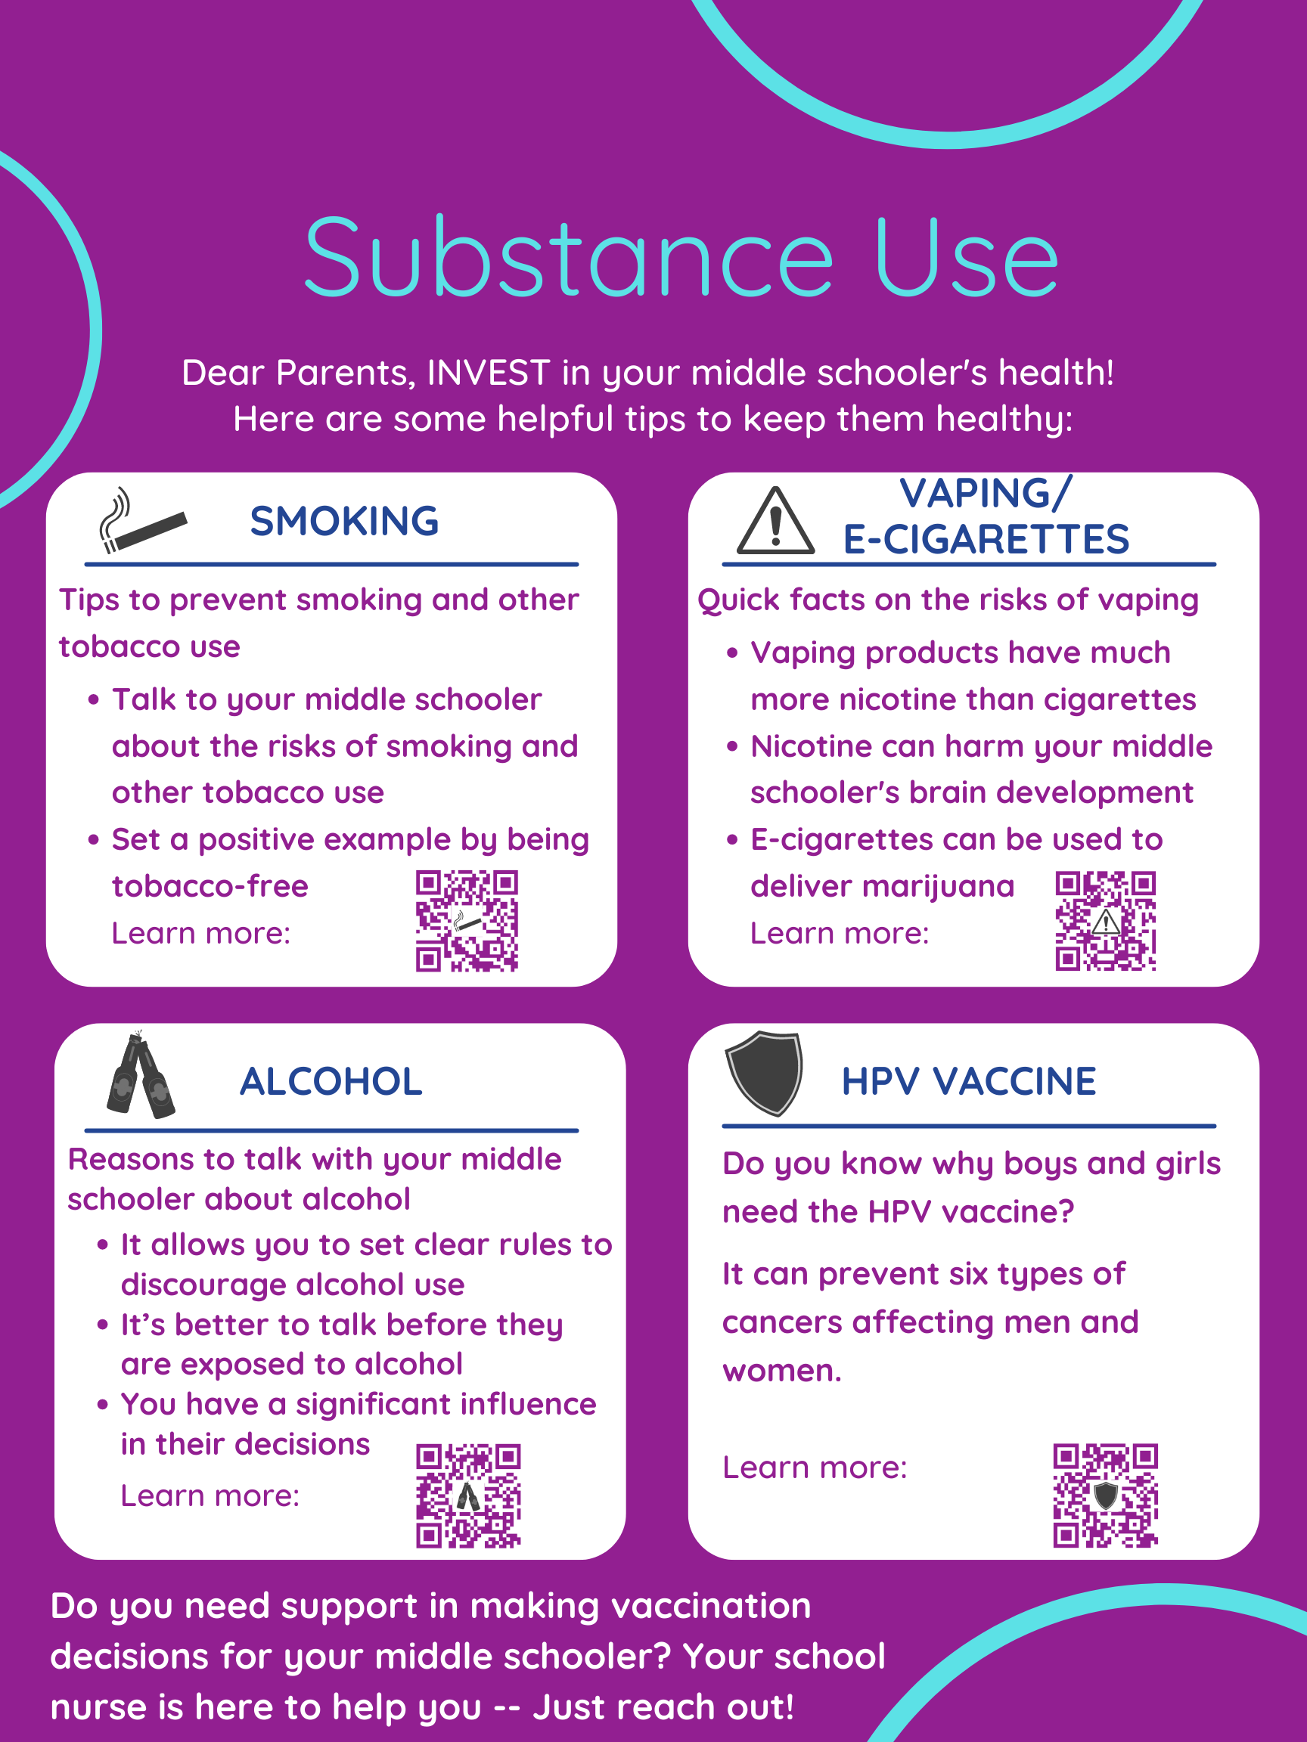
Add: School (district) logo here
bit.ly/3scVAul
bit.ly/3GPW65H
bit.ly/2Y15UZJ
bit.ly/3pVm9D5

Slide 17
Add: School (district) logo here
Add:
SCHOOL NURSE’S NAME
Contact info
Slogan or quote
Add: Picture of school nurse here
[Add: Contact information of local vaccination providers including pediatricians, family medicine and immediate care offices, and the county health department]

